Slide 1
Types of Sensors

Slide 2
Sensors
A Sensor is an electronic device that is used to measure some sort of physical parameters (e.g. temperature, pressure, light intensity, etc).
The output of an electronic sensor is an electrical signal that is either analog or digital.
Processing the sensor’s output can be done in hardware (using discrete electronic elements) or in software (using some sort of microcontrollers or MPUs).
Each sensor has a different working principle depending on the physical construction and the physical parameter it’s actually measuring.
The common thing between all sensors is they all convert a physical parameter (such as temperature) to an electric signal. But each one has a specific transfer function (for analog) or a specific communication bus as SPI, UART, etc (for digital). These specific details are demonstrated completely in the datasheet for each sensor with the typical connection diagram and how to interface it.

Slide 3
Sensors
A Sensor is an electronic device that is used to measure some sort of physical parameters (e.g. temperature, pressure, light intensity, etc). The output of an electronic sensor is an electrical signal that is either analog or digital. Processing the sensor’s output can be done in hardware (using discrete electronic elements) or in software (using some sort of microcontrollers or MPUs).

Slide 4
Sensors and actuators are two different components that often work together in equipment and systems to ensure they function effectively. They are opposite in terms of their functionality, but they can be found in the same areas and complement each other:
Sensors
Convert physical activity or changes into electrical signals. For example, sensors in security systems can detect unknown objects and raise alarms. Other examples include cameras, microphones, and home security systems.
Actuators
Take one form of energy as input and produce some form of motion, movement, or action. For example, actuators can regulate the flow of fuel to a gas turbine, operate valves and hydraulic cylinders in industrial plants, or drive events within equipment. Other examples include motor controllers, LED, and lasers.
Notes:
Application.
https://webbylab.com/blog/actuators-in-iot-guide/#:~:text=Different%20Types%20of%20Actuators%20in%20IoT,-IoT%20systems%20integrate&text=The%20actuator%20transforms%20mechanical%20motion,on%20the%20IoT%20device%20requirements.Sensors are often used to measure asset temperature, vibration, pressure or fluid levels. Industrial applications of actuators include operating dampers, valves, and couplings.

Slide 5
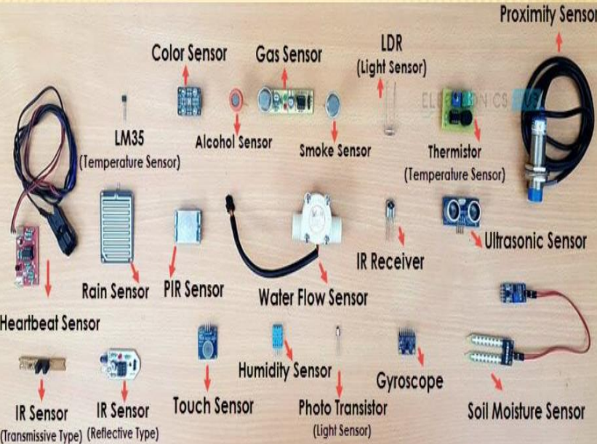
Notes:
https://kanchiuniv.ac.in/wp-content/uploads/2021/05/BMTF183T60-SENSORS-AND-ACTUATORS-1.pdf

Slide 6
Sensors -Types
Analog Output | Digital Output
The output of these sensors is an analog voltage that you can measure then determine the desired physical parameter using the sensor’s transfer function. It may also be capacitive or resistive or anything analog. | The output of these sensors is digital data that you can read via serial or parallel communication buses (as UART, SPI, I2C, etc). The typical format for the data is demonstrated exactly in the sensor’s datasheet.
Example: The temperature sensor (specifically LM35) is an analog sensor whose output | Example: The accelerometer sensor (ADXL345) is a digital sensor that sends out its output data via the I2C two-wire bus.

Slide 7
Sensor’s Physical Parameter Classification
Temperature Sensors | Chemical Sensors | Proximity Sensors | Touch Sensors
Light Sensors | Tilt Sensor | Metal Detectors | Cameras
Humidity Sensor | Vibration Sensor | Magnetic Sensor | Color Sensor
Current Sensor | Pressure Sensor | Fingerprint Sensor | GPS
Motor Speed Sensor | Bending Sensor | PIR Sensor | Position Sensor
Lidar Sensor | Ultrasonic Sensor | Gyroscope Sensor | Accelerometer Sensor
Digital Compass Sensor | Sound Sensor (Mic.) | IR Sensor | Odometer Sensor

Slide 8
Applications For Sensors
Automation
Robotics
Embedded Systems
Computers
Smart Cars
Avionics
Satellites
Smart Homes
Smartphones
Smart Watches
Energy plants
Remote Sensing
Communication

Slide 9
Sensors - Parameters
Range of Operation
Accuracy (Resolution)
Total Cost
Interfacing Method
Data Rate (For Digital Sensors)

Slide 10
Sensors - Parameters
Range of Operation
The most important factor to consider in a sensor is the operating range.
If you’re designing a boiler system that will control some liquid boiling at 500°c, You shouldn’t use a small LM35 sensor that can only read up to 150°c.
You should make sure that the sensor meets the range requirement of your application in order to get the right sensor for it.

Slide 11
Sensors - Parameters
Accuracy (Resolution)
Decide on the required resolution (accuracy) of the sensor your applications need prior to choosing a sensor.
For example, a temperature sensor with an accuracy of 1°c will be sufficient for a boiler embedded system’s design.
However, the same sensor with the same accuracy may not be sufficient for some critical scientific experiments or devices that require an accuracy of 0.1°c.
So, there is a trade-off and you have to make your own decision based on your system’s specifications.

Slide 12
Sensors - Parameters
Data Rate (For Digital Sensors)
Digital sensors can send you readings (data) at a rate we call the sampling rate.
Typically sensors’ rate is defined by ksp/s (kilo samples per second) which is a thousand sample points (readings) in a second.
Some sensors can supply up to a few Msp/s. Most of the time, it’s a programmable feature in sensor modules. And you have to check whether this rate of data supplies your MCU with the information it needs to run the algorithm or perform the required calculations flawlessly.

Slide 13
Types of Sensors
Semiconductor Temperature Sensors are the devices that come in the form of integrated circuits i.e. ICs hence, popularly known as IC temperature sensors.
These are the electronic devices manufactured in an identical fashion to present-day electronic semiconductor devices like microprocessors.
More than thousands of devices can be fabricated upon thin silicon wafers.
A whole new range of semiconductor temperature sensors is arriving from different manufacturers.
However, the most popular ones include AD590 and LM35.
Their design results from the fact that semiconductor diodes have temperature-sensitive voltage vs. current characteristics. When two identical transistors are operated at a constant ratio of collector current densities, the difference in base-emitter voltages is directly proportional to the absolute temperature

Slide 14
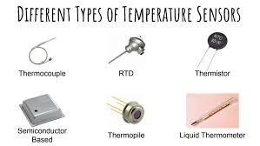
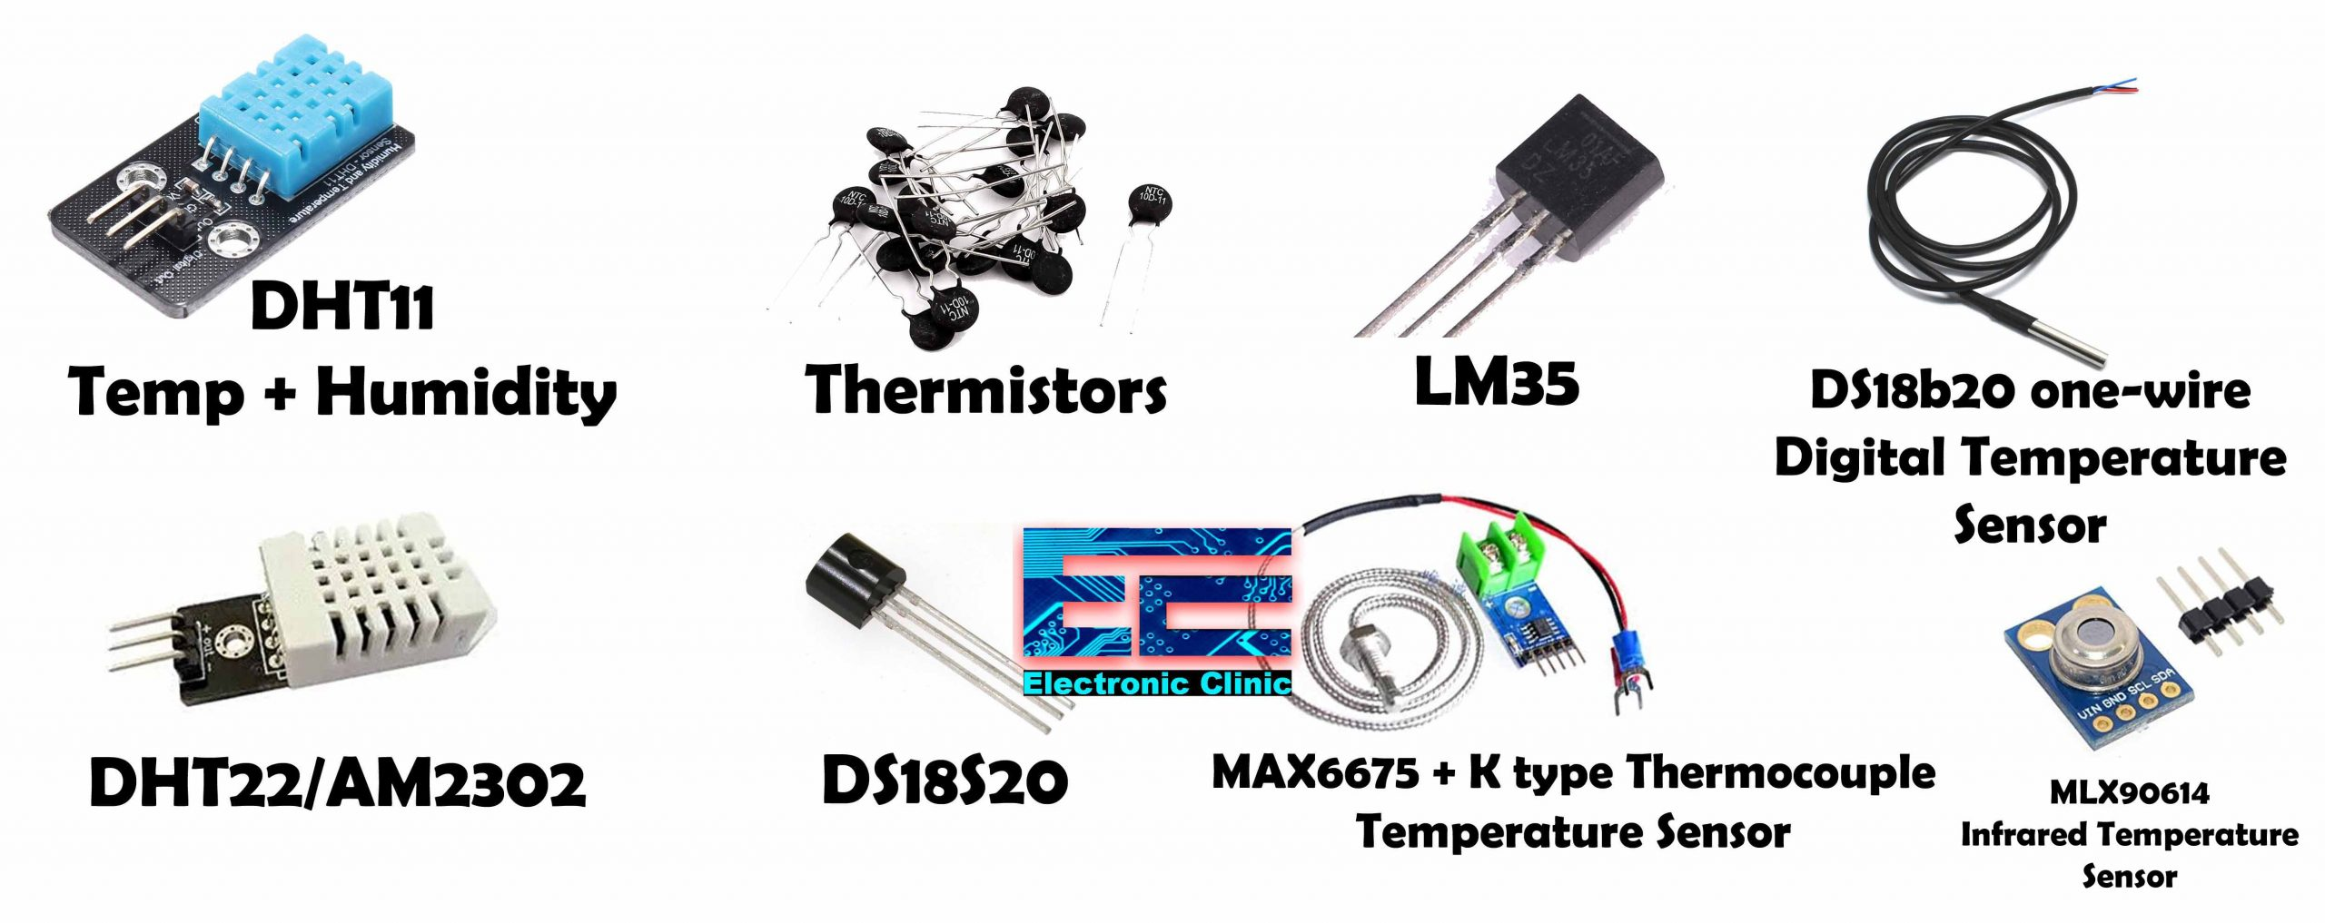
Types of Sensors

Slide 15
Temperature Sensors
Negative Temperature Coefficient (NTC) thermistor. The effective operating range is -50 to 250 °C.
Resistance Temperature Detector (RTD), also known as a resistance thermometer. Platinum RTDs offer a fairly linear output that is highly accurate (0.1 to 1 °C) across -200 to 600 °C. While providing the greatest accuracy, RTDs also tend to be the most expensive of temperature sensors.
Thermocouple. A thermocouple is an electrical device consisting of two dissimilar electrical conductors forming electrical junctions at differing temperatures. A thermocouple produces a temperature-dependent voltage as a result of the thermoelectric effect, and this voltage can be interpreted to measure temperature. Thermocouples are a widely used type of temperature sensor.

Slide 16
Types of Sensors Pressure sensors
Pressure sensors are used for measuring the pressure of gases and liquids.
Pressure sensors are used for control and monitoring in thousands of everyday applications. Pressure sensors can also be used to indirectly measure other variables such as fluid/gas flow, speed, water level, and altitude.

Slide 17
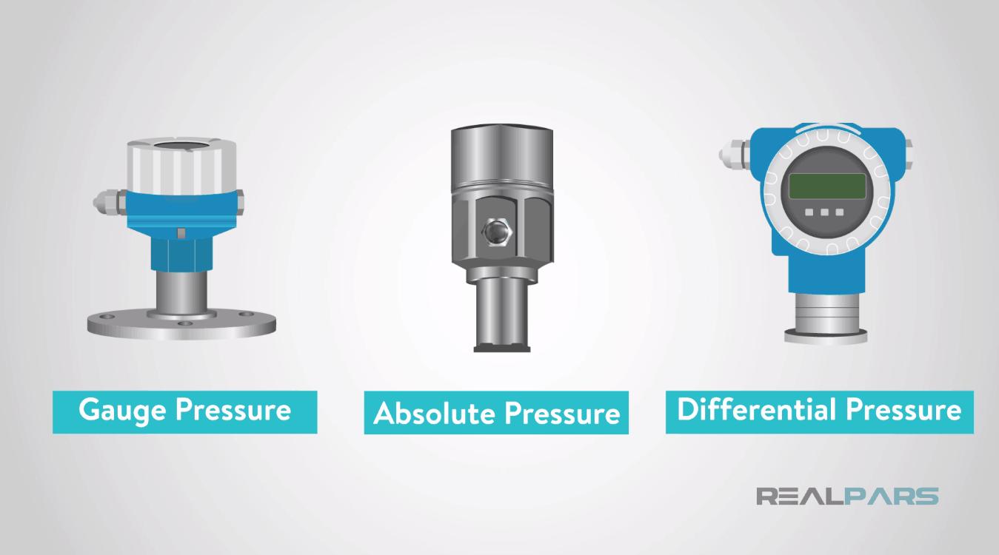
Different Types Of Pressure Sensors

Slide 18
Different Types Of Pressure Sensors
Pressure sensors can be classified in terms of pressure ranges they measure temperature ranges of operation, and most importantly the type of pressure they measure. Pressure sensors are variously named according to their purpose, but the same technology may be used under different names.

Slide 19
Different Types Of Pressure Sensors
1 Absolute pressure sensor This sensor measures the pressure relative to a perfect vacuum.
2 Gauge pressure sensor This sensor measures the pressure relative to atmospheric pressure. A tire pressure gauge is an example of gauge pressure measurement; when it indicates zero, then the pressure it is measuring is the same as the ambient pressure.
3 Vacuum pressure sensor This term can cause confusion. It may be used to describe a sensor that measures pressures below atmospheric pressure, showing the difference between low-pressure and atmospheric pressure, but it may also be used to describe a sensor that measures absolute pressure relative to a vacuum.

Slide 20
Different Types Of Pressure Sensors
4 Differential pressure sensor This sensor measures the difference between two pressures, one connected to each side of the sensor.
Differential pressure sensors are used to measure many properties, such as pressure drops across oil filters or air filters, fluid levels (by comparing the pressure above and below the liquid), or flow rates (by measuring the change in pressure across a restriction).
Technically speaking, most pressure sensors are really differential pressure sensors; for example, a gauge pressure sensor is merely a differential pressure sensor in which one side is open to the ambient atmosphere.

Slide 21
Chemical Sensors
A chemical sensor is a self-contained analytical device that can provide information about the chemical composition of its environment, that is, a liquid or a gas phase. The information is provided in the form of a measurable physical signal that is correlated with the concentration of a certain chemical species. Chemical sensors include the gas sensor, methane sensor, hydrogen sensor, Carbon dioxide sensor, etc.
Chemical sensors are widely used in biomedical sensing and diagnosing devices. This type of sensors is used for the diagnostics of gaseous issues such as the concentration of chemicals in human bodies. The monitoring purposes of chemical activities in the body are measured by chemical sensors. The high chemical sensitivity of graphene enables it to be the most desirable component in biomedical devices.

Slide 22
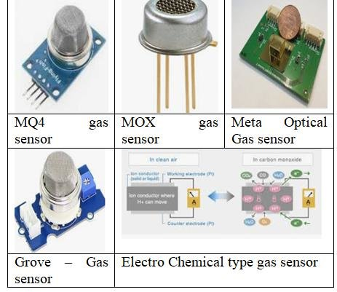
Types of Sensors
Gas Sensor | Carbon Dioxide Sensor | Alcohol Sensor | Methane Sensor

Slide 23
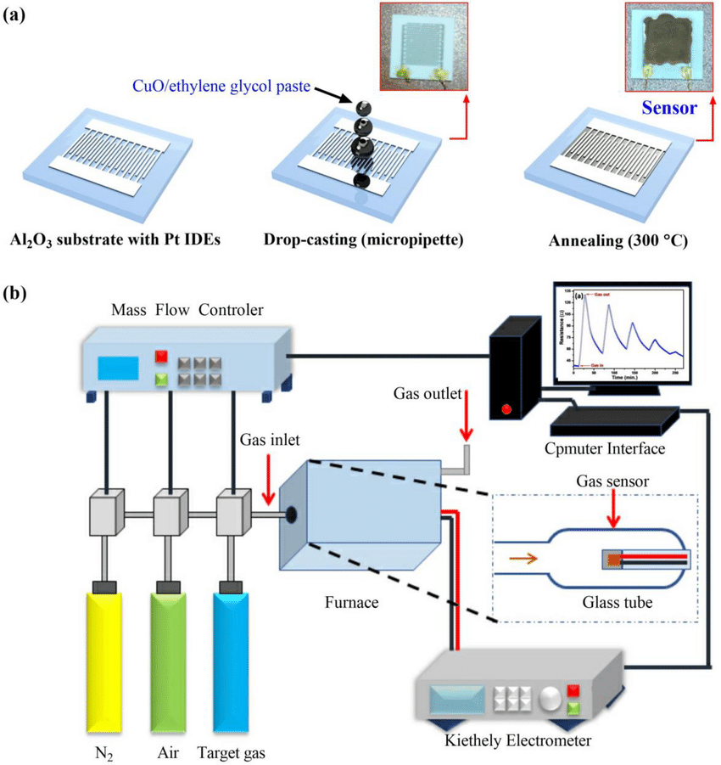

Slide 24
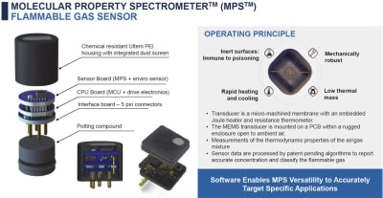

Slide 25
Humidity Sensor
The definition of humidity asserts that it’s the percentage of H2O presence in the atmosphere (air), it’s the amount of water vapor existing in the air of a specific area.
Humidity measurement in industries is critical because it may affect the business cost of the product and the health and safety of the personnel. Hence, humidity sensing is very important, especially in the control systems for industrial processes and human comfort

Slide 26
Humidity Sensor
Humidity also can affect and damage metallic equipment by accelerating the chemical corrosion process. In these areas, high humidity is not desirable at all. However, in some applications like farming the humidity is a good thing for several plants and hence it could be actually a good thing.

Slide 27
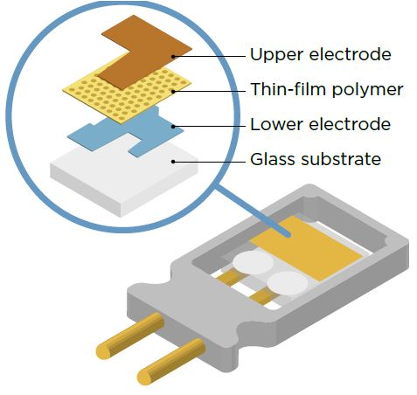
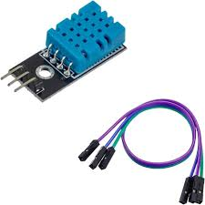

Slide 28
Current Sensors
A current sensor is an electronic device that can detect electric current DC or AC in a wire, and generates a signal proportional to that current.
The generated signal could be analog voltage or current or even a digital output.
The generated signal can be then used to display the measured current in an ammeter, or can be stored for further analysis in a data acquisition system, or can be used for the purpose of control.

Slide 29
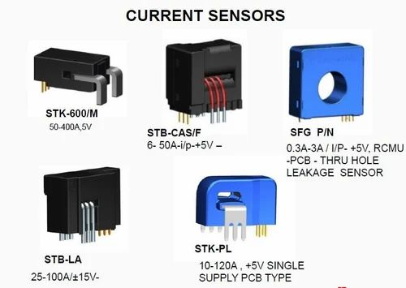
Current Sensors

Slide 30
Vibration Sensor
There are typically three different types of sensors that are being used in vibration detection: displacement, velocity, and acceleration.
Displacement sensors measure changes in distance between a machine’s rotating element and its stationary housing (frame).
Displacement sensors come in the form of a probe that threads into a hole drilled and tapped in the machine’s frame, just above the surface of a rotating shaft.
Velocity and acceleration sensors, by contrast, measure the velocity or acceleration of whatever element the sensor is attached to, which is usually some external part of the machine frame.
There are many applications that you can design and make using the vibration sensor and it ranges from small wearables to HVAC systems, other examples include: Automotive industrial applications and motor control and monitoring systems.

Slide 31
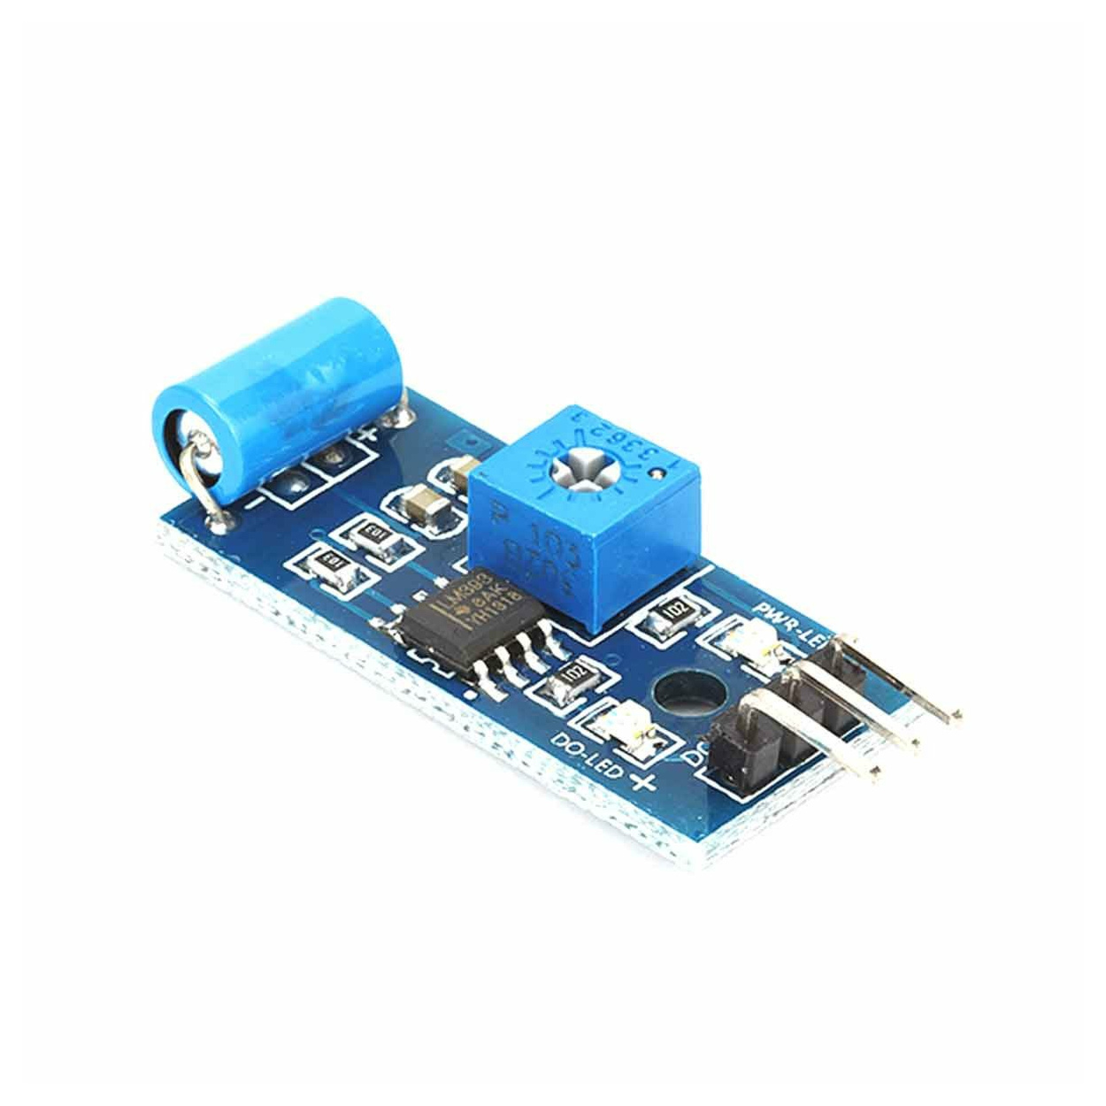
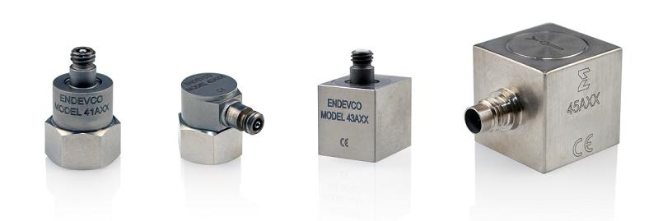
Vibration Sensor
Vibration sensing could be also useful for robotics especially mobile robots. You can tell if your robot did crash into something or whether it’s moving over a smooth or rough road. There are many possibilities and different ways to make use of the vibration sensor

Slide 32
Sound Sensors
There are many applications where you need to make your system sound-aware. Maybe respond to some sort of sound signals or voice commands or whatever.
There are many types of sound sensing devices,
First of which is the microphones which are the most common devices to pick up sound waves and turns it into an electric signal. And the second type is the piezoelectric elements that also converts the pressure into small electric signals. The sound travels through the air as a wave of pressure and that’s exactly what causes the piezoelectric elements to generate a simial wave but in the form of an electric signal.

Slide 33
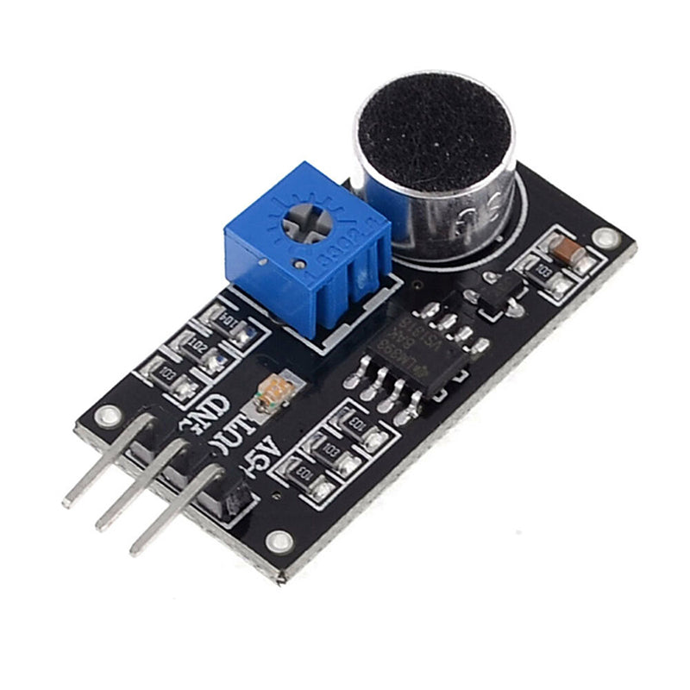
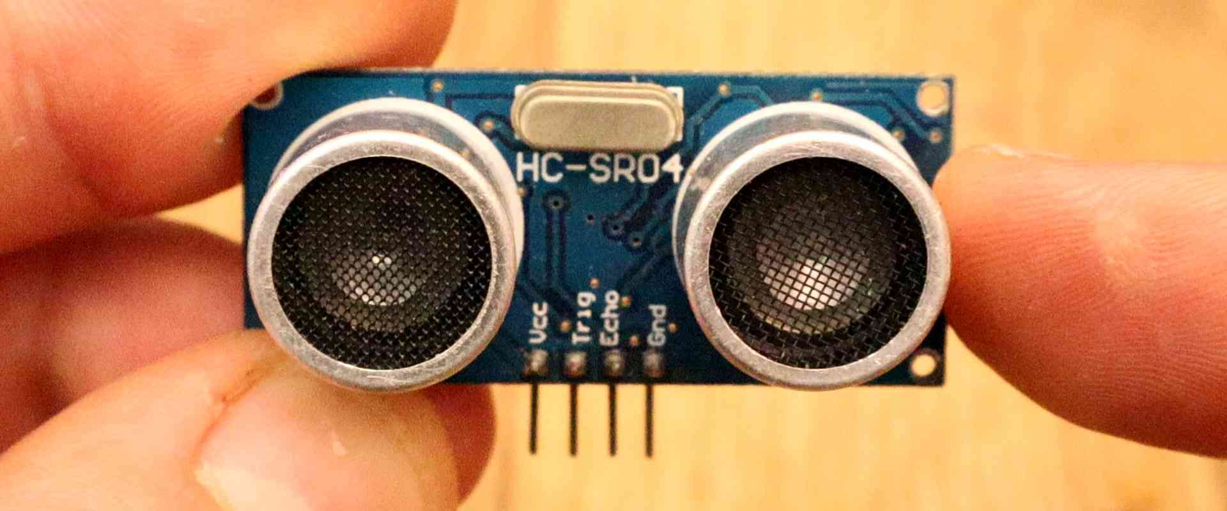

Slide 34
Microphones
A microphone is the most common sound sensor in the world.
It does exist in our smartphones, laptops, and all sound systems whether it’s embedded or standalone.
A typical microphone transforms the sound waves into electric signals that could be amplified or sent to a DSP (digital signal processor) for further processing or analysis.
There are different types of microphone depending on the construction and the working principle of it.
An electret microphone is a type of electrostatic capacitor-based microphone, which eliminates the need for a polarizing power supply by using a permanently charged material. An electret is a stable dielectric material with a permanently embedded static electric dipole moment (which, due to the high resistance and chemical stability of the material, will not decay for hundreds of years). The name comes from electrostatic and magnet; drawing the analogy to the formation of a magnet by the alignment of magnetic domains in a piece of iron.

Slide 35
Microphones
An electret microphone is a type of electrostatic capacitor-based microphone, which eliminates the need for a polarizing power supply by using a permanently charged material.
An electret is a stable dielectric material with a permanently embedded static electric dipole moment (which, due to the high resistance and chemical stability of the material, will not decay for hundreds of years). The name comes from electrostatic and magnet; drawing the analogy to the formation of a magnet by the alignment of magnetic domains in a piece of iron.

Slide 36
Piezoelectric Elements
A piezoelectric sensor is a device that uses the piezoelectric effect, to measure changes in pressure, acceleration, temperature, strain, or force by converting them to an electrical charge. Piezoelectric sensors are versatile tools for the measurement of various processes. They are used for quality assurance, process control, and for research and development in many industries.
They have been successfully used in various applications, such as in medical, aerospace, nuclear instrumentation, and as a tilt sensor in consumer electronics or a pressure sensor in the touchpads of mobile phones. In the automotive industry, piezoelectric elements are used to monitor combustion when developing internal combustion engines.

Slide 37
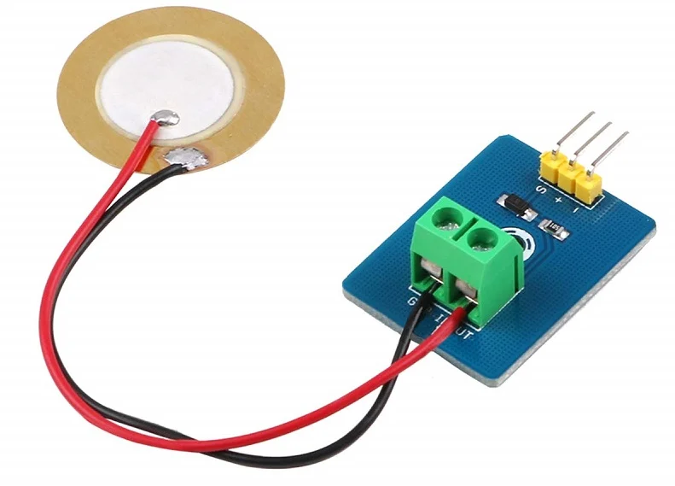

Slide 38
Light Sensor
Light sensors are the type of sensors that can detect the light intensity in the surrounding environment. There are many types of light sensors depending on the principle of operation and the type of light energy it can detect (ambient light, IR, laser, etc). In this article, I’ll mention a couple of light sensors, the LDR (light dependent resistance) and the photoconductive cell.

Slide 39
Accelerometer Sensor
Accelerometers are electronic sensors that measure acceleration, which is the rate of change of the velocity of an object.
They measure in meters per second squared (m/s²) or in G-forces (g). A single G-force for us here on planet Earth is equivalent to 9.8 m/s², but this does vary slightly with elevation (and will be a different value on different planets due to variations in gravitational pull).
Accelerometers are useful for sensing vibrations in systems or for orientation applications.
Accelerometers can measure acceleration on one, two, or three axes. 3-axis units are becoming more common as the cost of development for them decreases. Generally, accelerometers contain capacitive plates internally. Some of these are fixed, while others are attached to minuscule springs that move internally as acceleration forces act upon the sensor. As these plates move in relation to each other, the capacitance between them changes. From these changes in capacitance, the acceleration can be determined

Slide 40
Accelerometer Sensor
Accelerometers can measure acceleration on one, two, or three axes. 3-axis units are becoming more common as the cost of development for them decreases.
Generally, accelerometers contain capacitive plates internally. Some of these are fixed, while others are attached to minuscule springs that move internally as acceleration forces act upon the sensor.
As these plates move in relation to each other, the capacitance between them changes. From these changes in capacitance, the acceleration can be determined

Slide 41
IR Sensor
There are different sensors that depend on the infrared light as a working principle for them.
This includes the photo-interrupter that consists of an IR LED and a photodiode that responds to IR light.
The most important and common example we see every day is the remote controls for TVs, Airconditioners, etc. The remote control is typically an IR transmitter LED sending bursts of IR light (data) and the receiver has a photodiode that detects these IR messages and responds correspondingly.

Slide 42
IR Sensor
An IR LED is a type of diode or simple semiconductor.
Electric current is allowed to flow in only one direction in diodes. Emitting infrared rays ranging from 700 nm to 1 mm wavelength.
Different IR LEDs may produce infrared light of differing wavelengths, just like different LEDs produce light of different colors.
An IR sensor is an electronic device that detects IR radiation falling on it. Proximity sensors (used in touchscreen phones and edge avoiding robots), contrast sensors (used in line following robots) and obstruction counters/sensors (used for counting goods and in burglar alarms) are some applications involving IR sensors.

Slide 43
Proximity Sensors
A proximity sensor is a sensor able to detect the presence of nearby objects without any physical contact.
A proximity sensor often emits an electromagnetic field or a beam of electromagnetic radiation (infrared, for instance), and looks for changes in the field or return signal.
The object being sensed is often referred to as the proximity sensor’s target. Different proximity sensor targets demand different sensors. For example, a capacitive proximity sensor or photoelectric sensor might be suitable for a plastic target; an inductive proximity sensor always requires a metal target.

Slide 44
Proximity Sensors Types
Capacitive Proximity Sensing
Capacitive proximity sensors can detect both metallic and non-metallic targets in powder, granulate, liquid, and solid form.
This, along with their ability to sense through nonferrous materials, makes them ideal for sight glass monitoring, tank liquid level detection, and hopper powder level recognition.
In capacitive sensors, the two conductive plates (at different potentials) are housed in the sensing head and positioned to operate as an open capacitor. Air acts as an insulator; at rest, there is little capacitance between the two plates.

Slide 45
Proximity Sensors Types
Inductive Proximity Sensing
These non-contact proximity sensors detect ferrous targets, ideally mild steel thicker than one millimeter.
They consist of four major components: a ferrite core with coils, an oscillator, a Schmitt trigger, and an output amplifier. The oscillator creates a symmetrical, oscillating magnetic field that radiates from the ferrite core and coil array at the sensing face.
When a ferrous target enters this magnetic field, small independent electrical currents called eddy currents are induced on the metal’s surface.
This changes the reluctance (natural frequency) of the magnetic circuit, which in turn reduces the oscillation amplitude. As more metal enters the sensing field the oscillation amplitude shrinks and eventually collapses.

Slide 46
PIR Sensor
A passive infrared sensor (PIR sensor) is an electronic sensor that measures infrared (IR) light radiating from objects in its field of view. They are most often used in PIR-based motion detectors. PIR sensors are commonly used in security alarms and automatic lighting applications. PIR sensors detect general movement but do not give information on who or what moved. For that purpose, an active IR sensor is required.
PIR sensors are commonly called simply PIR. The term passive refers to the fact that PIR devices do not radiate energy for detection purposes. They work entirely by detecting infrared radiation (radiant heat) emitted by or reflected from objects.

Slide 47
Heartbeat Sensor
A heartbeat sensor is designed to give a digital output of heat beat when a finger is placed on it. When the heartbeat detector is working, the beat LED flashes in unison with each heartbeat. This digital output can be connected to the microcontroller directly to measure the Beats Per Minute (BPM) rate.

Slide 48
Interfacing with 8051
https://www.electronicwings.com/8051/pir-motion-sensor-interface-with-8051
https://www.electronicwings.com/8051/dht11-sensor-interfacing-with-8051
https://www.electronicwings.com/8051/ultrasonic-module-hc-sr04-interfacing-with-8051
https://embetronicx.com/tutorials/microcontrollers/8051/ir-sensor-interfacing-with-8051/
https://embetronicx.com/tutorials/microcontrollers/8051/sound-sensor-interfacing-with-8051/
https://www.slideshare.net/irfanahmaddgk/sensor-interfacing-in-8051
https://www.slideshare.net/slideshow/interfacing-of-temperature-sensor-lm-35-with-8051pdf/257590372

